Slide 1

Consumer Credit Analysis
Team Credit Safari
Dominic, Taryn & Tiffany
Data Analytics Bootcamp
Project 1

Slide 2
Project Description
Experian reports that the average FICO score in the US stands at 715. Although there isn't a one-size-fits-all 'average consumer,' credit bureaus rely on various quantifiable trends and data to assess creditworthiness. In this project, we aim to identify demographic and psychographic factors linked to higher and lower average credit scores. We'll employ fundamental concepts like data cleaning and statistical analysis to explore the impact of factors such as payment history, debt-to-income ratio, and age of accounts on an individual's credit score.

Slide 3
Research Questions
What are the three primary positive behavioral patterns correlated with elevated credit scores?
What are the three principal adverse behavioral patterns associated with diminished credit scores?
In which geographic region do we observe the highest mean
credit scores?
$
$
$

Slide 4
Purpose
Investigate the potential of publicly accessible data to unveil behaviors influencing credit scores, both positively and negatively.
Explore the existence of geographic concentrations where individuals with elevated credit scores predominantly reside.
Deliver the findings in a polished and meticulously structured format, ensuring clarity and professionalism in the presentation of data analysis results.

Slide 5

Datasets Used
A. Credit_score.csv
B. loan_data_2015.csv

Slide 6
Methods
Acquired extensive datasets.
Processed dataset:
Removed null values
Identified and addressed outliers
Plotted and subsequently removed outliers.
Developed a heatmap to visualize correlations across the entire dataset.
Generated scatterplots with regression lines to elucidate correlations clearly.
Conducted linear correlation analysis across 40 different dimensions, both individually and in relation to credit score.
Conducted Spearman correlation analysis on income-to-credit score and debt-to-income ratio-to-credit score to account for non-linear correlations.

Slide 7
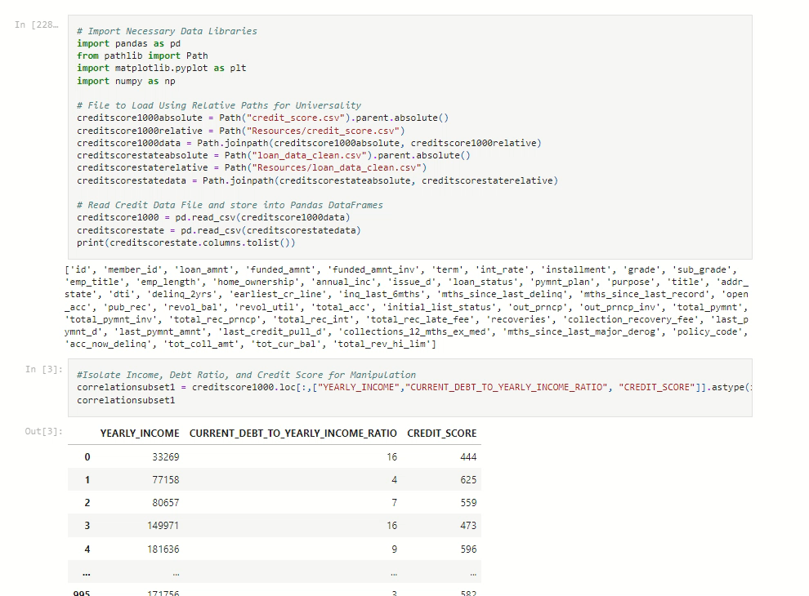
Methods (Continued)

Slide 8
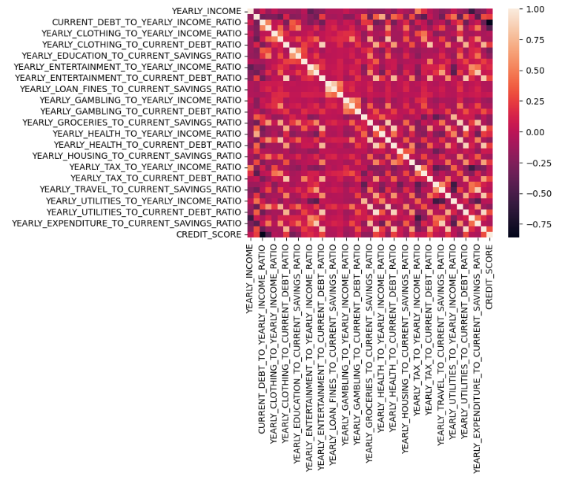
Methods (Continued)
Heatmap
The heatmap shows the correlation between all columns in the dataset:
The strength of correlation increases as the square color lightens, reaching its maximum value of 1.00.
Conversely, a darker square indicates a weaker correlation.
The highest correlation value of 1.0 is observed when comparing a column to itself, forming the diagonal line.

Slide 9
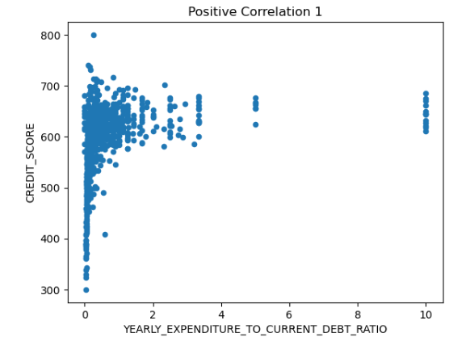

Results
Strongest Positive Correlations
Yearly Expenditure : Current Debt (0.307594)
This indicates the ratio between yearly expenditure and current debt. A higher ratio suggests that individuals manage their debt responsibly in relation to their annual spending, which is positively associated with a higher credit score.

Slide 10
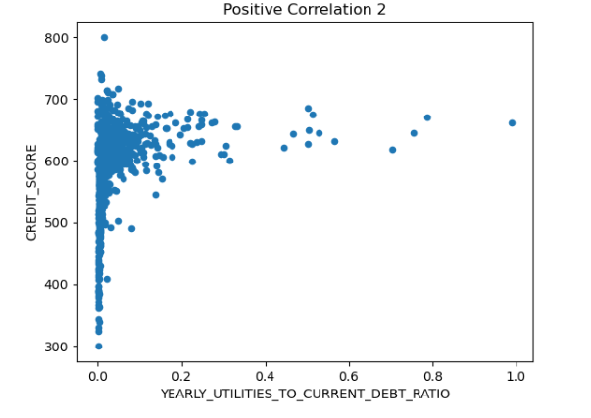
Results
Strongest Positive Correlations
Yearly Utilities : Current Debt (0.303482)
This represents the ratio between yearly utility expenses and current debt. A higher ratio implies efficient management of debt in comparison to utility costs, which typically reflects responsible financial behavior and contributes positively to credit scores.

Slide 11
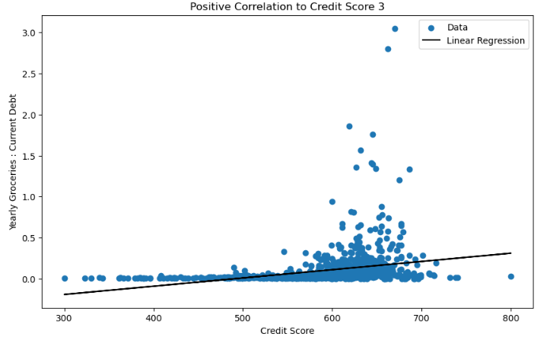


Results
Strongest Positive Correlations
Yearly Groceries : Current Debt (0.286999)
This measures the ratio between yearly grocery expenses and current debt. A higher ratio indicates prudent management of debt relative to grocery spending, suggesting a responsible approach to financial management and contributing positively to credit scores."

Slide 12
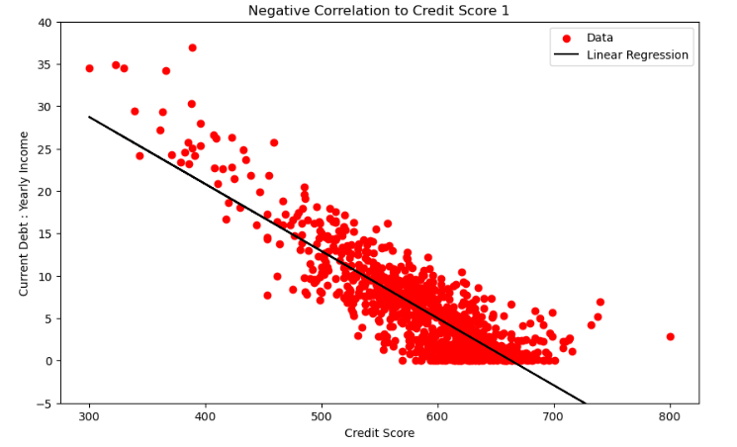

Results
Strongest Negative Correlations
Current Debt : Yearly Income (-0.857900)
This ratio compares an individual's current debt to their yearly income. A higher ratio suggests that a significant portion of their income is allocated towards debt repayment, indicating potential financial strain and, consequently, a negative impact on credit scores.

Slide 13
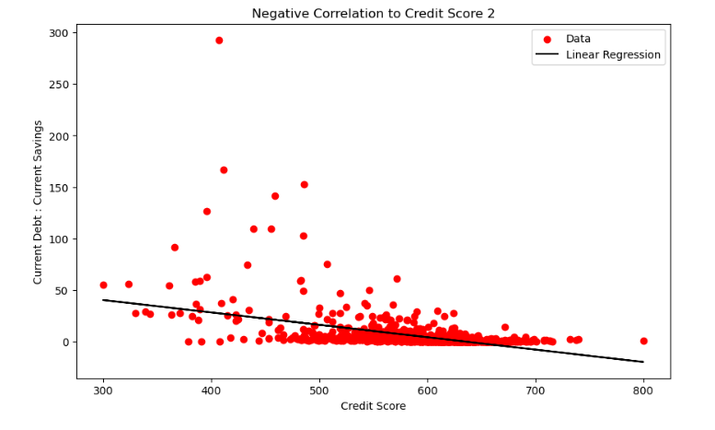

Results
Strongest Negative Correlations
Current Debt : Current Savings (-0.454068)
This ratio evaluates the relationship between an individual's current debt and their current savings. A higher ratio implies a lack of sufficient savings to cover debt obligations, potentially indicating financial instability and leading to lower credit scores.

Slide 14
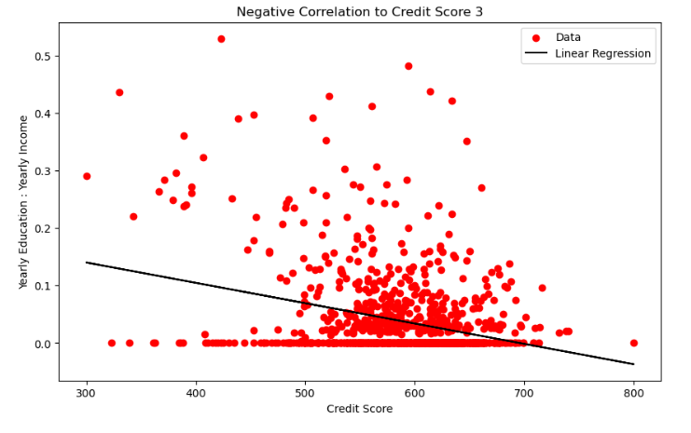




Results
Strongest Negative Correlations
Yearly Education : Yearly Income (-0.303268)
This compares an individual's yearly education expenses to their yearly income. A higher ratio indicates a significant portion of income allocated towards education costs, potentially leaving fewer resources available for managing debt and other financial obligations, thereby negatively affecting credit scores.

Slide 15
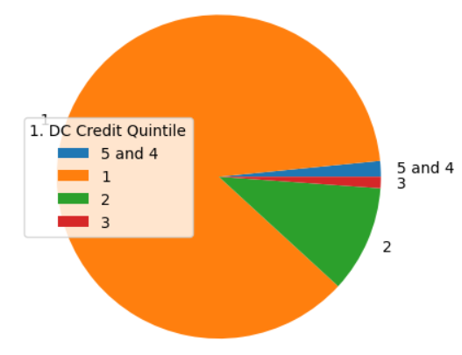
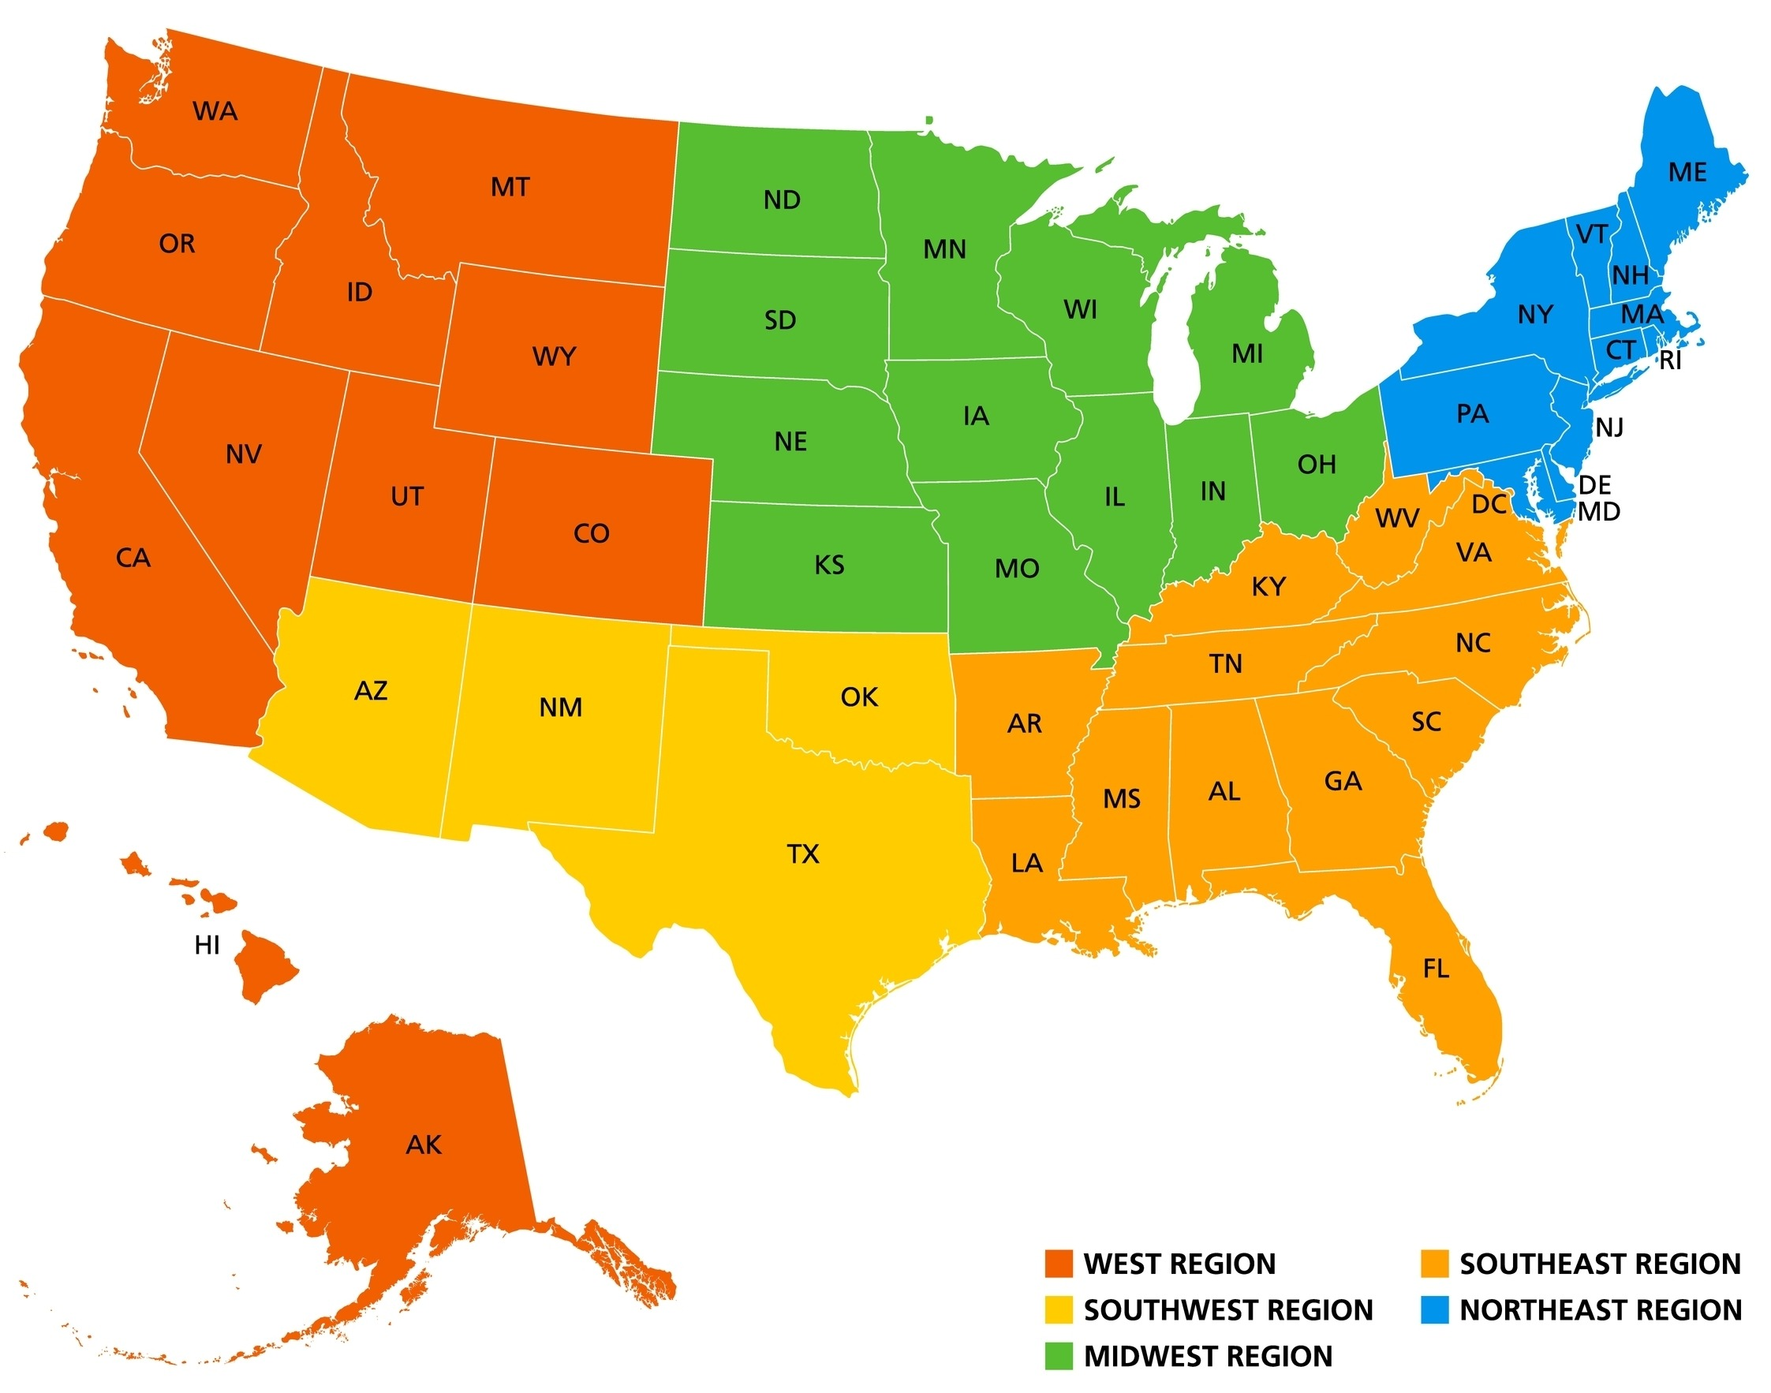
Results
Geographical
Washington, D.C.
Southeast Region

Slide 16
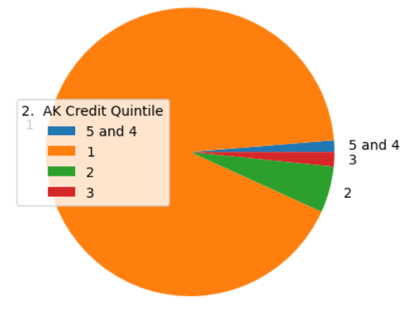
Results
Geographical
Alaska
West Region

Slide 17
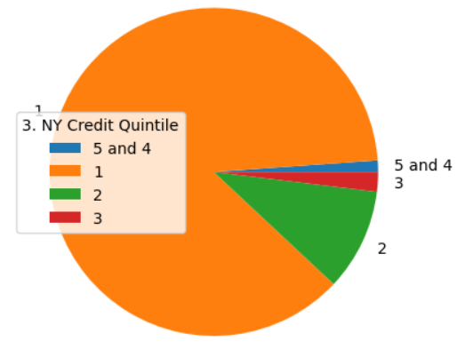
Results
Geographical
New York
Northeast Region

Slide 18
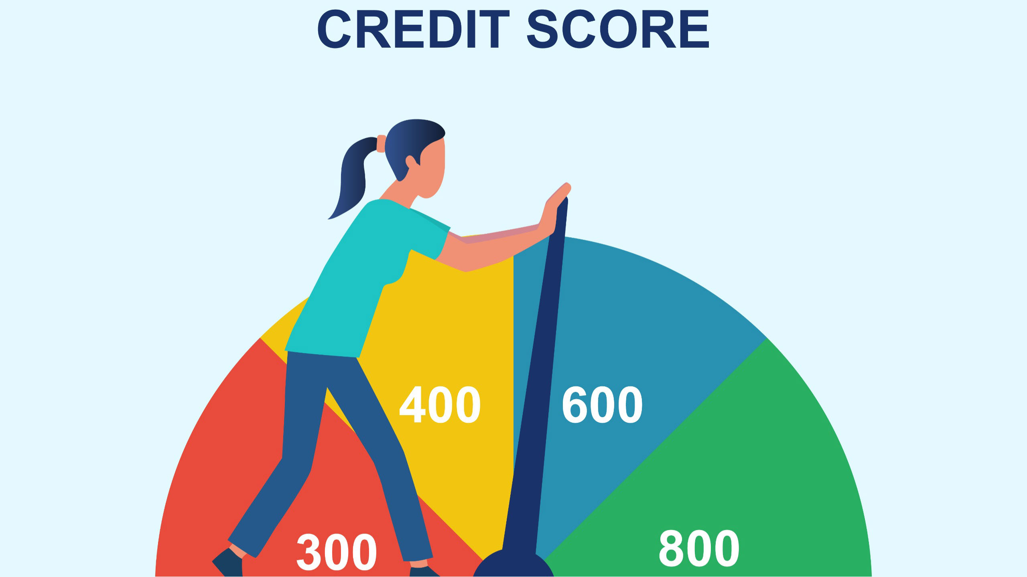
Conclusion
Managing yearly spending on essentials like utilities and groceries in proportion to current debt positively impacts credit scores. This emphasizes the importance of responsible financial management for maintaining good credit health. Having said that, behaviors such as a high current debt-to-yearly income ratio, a high current debt-to-current savings ratio, and a high ratio of yearly education expenses to yearly income exhibit the strongest negative correlations with credit scores. These behaviors indicate potential financial strain, instability, and a limited capacity to manage debt effectively, thereby adversely affecting credit scores.
Certain regions in the United States consistently exhibit high average credit scores, namely Washington, DC, Alaska, and New York. These areas, situated in the Southeast, West, and Northeast regions respectively, demonstrate strong financial health and responsible credit management practices among residents. Overall, our analysis highlights these regions as having higher credit scores compared to others, indicative of sound financial practices.

Slide 19
Questions?
Data Analytics Bootcamp
Project 1

Slide 20
Resources
https://www.kaggle.com/datasets/conorsully1/credit-score/data
https://www.kaggle.com/datasets/somyaagarwal69/loan-data-2015
https://stackoverflow.com/questions/50730408/implementing-if-else-in-python-dataframe-using-lambda-when-there-are-
The pandas apply function. Pandas Apply.(n.d.)
https://www.homeandlearn.co.uk/data-analysis-pandas/pandas-apply-function.html
5. Python - plot a pie chart for pandas dataframe with matplotlib?. Tutorialspoint. (n.d.).
https://www.tutorialspoint.com/python-plot-a-pie-chart-for-pandas-dataframe-with-matplotlib
6. Real Python. (2023, October 21). NumPy, scipy, and pandas: Correlation with python.
https://realpython.com/numpy-scipy-pandas-correlation-python/#rank-correlation
7. https://medium.com/@szabo.bibor/how-to-create-a-seaborn-correlation-heatmap-in-python-834c0686b88e
8. https://medium.com/geekculture/simple-linear-regression-bd4348e1ee62
9. ASU Data Analytics Course Activities

